Slide 1
Analyzing and Recording Transactions
Chapter 2
Wild and Shaw
Fundamental Accounting Principles
25th Edition
Copyright ©2021 McGraw-Hill Education. All rights reserved. No reproduction or distribution without the prior written consent of McGraw-Hill Education.

Slide 2
Chapter 2 Learning Objectives
CONCEPTUAL
C1 Describe an account and its use in recording transactions.
C2 Define debits and credits and explain double-entry accounting.
ANALYTICAL
A1 Analyze and record transactions and their impact on financial statements.
.
PROCEDURAL
P1 Prepare financial statements from a trial balance.

Slide 3
Describe an account and its use in recording transactions.
Learning Objective C1

Slide 4
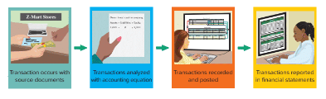
Basis of Financial Statements
Business transactions and events are the starting points of financial statements. The process from transactions to financial statements is as follows:
Identify transaction and event from source documents.
Analyze transaction and event using the accounting equation.
Record relevant transactions and events in a journal.
Post journal information to ledger accounts.
Prepare and analyze trial balance and financial statements.
Learning Objective C1: Describe an account and its use in recording transactions.
Notes:
Business transactions and events are the starting points of financial statements. The process to go from transactions and events to financial statements includes the following:
Identify each transaction and event from source documents.
Analyze each transaction and event using the accounting equation.
Record relevant transactions and events in a journal.
Post journal information to ledger accounts.
Prepare and analyze the trial balance and financial statements.

Slide 5
Source Documents
Source documents identify and describe transactions entering the accounting system.
Examples:
Bills from suppliers
Sales receipts
Checks
Purchase orders
Payroll records
Bank statements
Learning Objective C1: Describe an account and its use in recording transactions.
Notes:
Source documents identify and describe transactions and events entering the accounting system. They can be in hard copy or electronic form. Examples are sales receipts, checks, purchase orders, bills from suppliers, payroll records, and bank statements.
Source documents provide objective and reliable evidence about transactions and events and their amounts.

Slide 6
The Account Underlying Financial Statements
An account is a record of increases and decreases in a specific asset, liability, equity, revenue, or expense.
The general ledger is a record of all accounts and their balances.
Learning Objective C1: Describe an account and its use in recording transactions.
Notes:
An account is a record of increases and decreases in a specific asset, liability, equity, revenue, or expense. The general ledger is a record of all accounts and their balances.

Slide 7
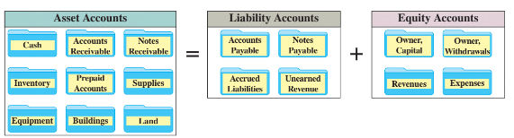
The Account and Its Analysis
Exhibit 2.1
Learning Objective C1: Describe an account and its use in recording transactions.
Notes:
Recall the basic accounting equation – Assets are equal to Liabilities plus Equity.
The equity section is composed of Owner, Capital and Owner, Withdrawals accounts as well as revenues and expenses.
Asset accounts – Assets are resources owned or controlled by a company and that have expected future benefits. Most accounting systems include (at a minimum) separate accounts for the assets described, such as cash, accounts receivable, notes receivable, and prepaid accounts.
Liability accounts – Liabilities are claims (by creditors) against assets, which means they are obligations to transfer assets or provide products or services to other entities. Creditors often use a balance sheet to help decide whether to loan money to a company. A loan is less risky if the borrower’s liabilities are small in comparison to assets because this means there are more resources than claims on resources. Common liability accounts are accounts payable, notes payable, unearned revenue accounts, and accrued liabilities.
Equity accounts – The owner’s claim on a company’s assets is called equity or owner’s equity. Equity is the owner’s residual interest in the assets of a business after subtracting liabilities.

Slide 8
Asset Accounts
Cash
Land
Accounts Receivable
Asset Accounts
Buildings
Notes Receivable
Equipment
Prepaid Accounts
Supplies
Learning Objective C1: Describe an account and its use in recording transactions.
Notes:
Here is a listing of common asset accounts we are likely to find in all businesses.
Cash reflects a company’s cash balances. It includes money and any funds that a bank accepts for deposit (coins, checks, money orders, and checking account balances).
Accounts Receivable are held by a seller and are promises of payment from customers to sellers. These transactions are often called credit sales or sales on account (or on credit). Accounts receivable are increased by credit sales on account.
Prepaid accounts, also called prepaid expenses, are assets that represent prepayments of future expenses (expenses expected to be incurred in one or more future accounting periods). When the expenses are later incurred, the amounts in prepaid accounts are transferred to expense accounts. Examples include prepaid insurance, prepaid rent, and prepaid services.
Supplies accounts are assets until they are used when they become an expense. Unused supplies are an asset and are often grouped by purpose including office supplies and store supplies.
Notes Receivable – written promise of another entity to pay a specific sum of money on a specified future date to the holder of the note.
Equipment accounts are assets. Its cost is allocated over time to expense, called depreciation. Equipment is often grouped by purpose such as office equipment and store equipment.
Building accounts include stores, offices, warehouses, and factories are assets. Cost of buildings is allocated over time to expense, called depreciation.
Land is an asset and is reported in an account separate from the buildings located on them.

Slide 9
Liability Accounts
Accounts Payable
Notes Payable
Liability Accounts
Accrued Liabilities
Unearned Revenue
Learning Objective C1: Describe an account and its use in recording transactions.
© McGraw-Hill Education
Notes:
Liabilities are claims by creditors against assets. Creditors are individuals and organizations that have rights to receive payments from a company.
This is a listing of common liability accounts we are likely to see in the general ledger.
Accounts payable are promises to pay later, which usually come from purchases of merchandise for resale.
A note payable is a written promissory note to pay a future amount.
Accrued liabilities are amounts owed that are not yet paid.
Unearned revenue is a liability that is settled in the future when a company delivers its product or services. If you subscribe to a magazine, you generally pay a one-year subscription in advance. For the publishing company, cash is received but nothing has been done to earn the revenue. As the magazine is delivered to you, the publishing company recognizes a portion of the money received as revenue. At the end of the year, all the revenue will be earned and the liability no longer exists.

Slide 10
Equity Accounts
-
Owner, Withdrawals
+
Owner, Capital
Equity Accounts
+
Revenues
-
Expenses
© McGraw-Hill Education
Learning Objective C1: Describe an account and its use in recording transactions.
Notes:
The owner’s claim on a company’s assets is called equity or owner’s equity. Equity is the owner’s residual interest in the assets of a business after deducting liabilities.
Equity is impacted by four types of accounts:
Owner, Capital
Owner, Withdrawals
Revenues
Expenses
Owner Capital increases both assets and equity. The increase to equity is recorded in an account titled Owner, Capital. Owner investments are not revenues of the business.
Owner Withdrawals are owner withdrawals for personal use, which decreases both company assets and total equity. The decrease to equity is recorded in an account titled Owner, Withdrawals. Withdrawals are not expenses of the business; they are simply the opposite of owner investments.
Sales of products and services to customers are recorded in revenue accounts, which increase equity. Examples of revenue accounts are Sales, Commissions Revenue, Professional Fees Revenue, Rent Revenue, and Interest Revenue. Revenues always increase equity.
Costs of providing products and services are recorded in expense accounts, which decrease equity. Examples of expense accounts are Advertising Expense, Salaries Expense, Rent Expense, Utilities Expense, and Insurance Expense. Expenses always decrease equity.

Slide 11

Expanded Equity
Revenues and common stock increases equity.
Expenses and dividends decrease equity.
Exhibit 2.2
© McGraw-Hill Education
Learning Objective C1: Describe an account and its use in recording transactions.
Notes:
Remember the expanded accounting equation shown here. Revenues increase the equity side of the equation and expenses decrease equity. In addition, owner investments are recorded in Owner, Capital and increase equity and Owner, Withdrawals decrease equity. Withdrawals are distributions of assets to its owners, which decreases company assets and total equity. Withdrawals are not expenses of the business; they are simply the opposite of owner investments.

Slide 12
Define debits and credits and explain double-entry accounting.
Learning Objective C2
© McGraw-Hill Education 2-15

Slide 13
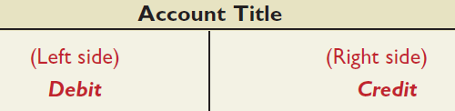
Debits and Credits
A T-account represents a ledger account and is used to show the effects of transactions.
Exhibit 2.5
Learning Objective C2: Define debits and credits and explain double-entry accounting.
© McGraw-Hill Education
Notes:
Accountants often use a T-account to represent a general ledger account. The account title is entered on the top of the T-account. The left side of a T-account is always called the debit side, and the right side is always called the credit side. This terminology comes from the time when the first double-entry system was developed. We still use the terms as a convention. The term debit or credit, by itself, does not mean increase or decrease. Whether a debit or a credit is an increase or decrease depends on the account. The difference between total debits and total credits for an account is the account balance. When the sum of the debits exceed the sum of the credits in a particular account, the account has a debit balance. When total debits equal total credits, the account has a zero balance.

Slide 14
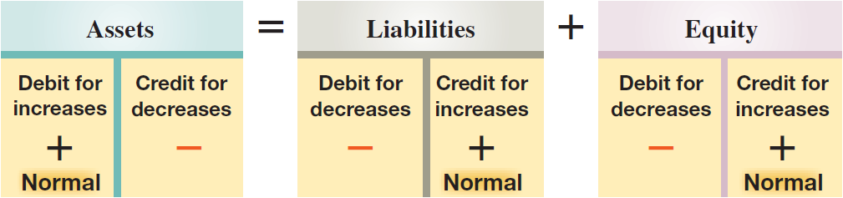
Double-Entry Accounting
=
+
Assets
Liabilities
Equity
Exhibit 2.6
© McGraw-Hill Education
Learning Objective C2: Define debits and credits and explain double-entry accounting.
Notes:
Double-entry accounting demands the accounting equation remain in balance which means that for each transaction:
● At least two accounts are involved, with at least one debit and one credit.
● The total amount debited must equal the total amount credited.
Net increases or decreases on one side have equal net effects on the other side.
For example, a net increase in assets must be accompanied by an equal net increase on the liabilities and equity side.
Some transactions affect only one side of the equation, such as acquiring a land asset by giving up a cash asset, but their net effect on this one side is zero.
The left side is the normal balance side for assets, and the right side is the normal balance side for liabilities and equity. This matches their layout in the accounting equation, where assets are on the left side of this equation and liabilities and equity are on the right.
It will take you a short while to become accustomed to using the terms debit and credit, but with practice you will master the concept easily.

Slide 15
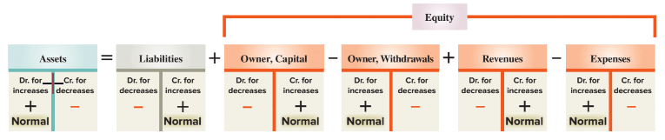
Double-Entry Accounting: Expanded Accounting Equation
Here is the expanded accounting equation showing the equity section.
Exhibit 2.7
Learning Objective C2: Define debits and credits and explain double-entry accounting.
© McGraw-Hill Education
Notes:
Equity increases from revenues and owner investments and it decreases from expenses and owner withdrawals. We see this by expanding the accounting equation to include debits and credits in double-entry form.
Increases (credits) to owner, capital and revenues increase equity;
increases (debits) to owner, withdrawals and expenses decrease equity.
The normal balance of each account (asset, liability, owner, capital, withdrawals, revenue, or expense) is the side where increases are recorded.

Slide 16
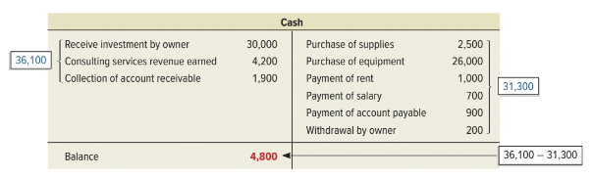
Double-Entry Accounting: Account Balance
An account balance is the difference between the increases and decreases in an account. Notice the T-Account.
Exhibit 2.8
© McGraw-Hill Education
Learning Objective C2: Define debits and credits and explain double-entry accounting.
Notes:
We determined the balance in the accounts in the last chapter, but in this chapter we will look at a more comprehensive way to determine an account balance.
The Cash account is an asset, so increases, or receipts, are shown on the debit, or left side, and decreases, or payments, are shown on the credit side, or right side. To determine if an account has a debit or credit balance, we total the right and left sides and place the balance on the larger side. In this example, our increases in Cash amount to $36,100 and the decreases total $31,300 so the Cash account has a debit, or positive balance of $4,800.

Slide 17
Analyze and record transactions and their impact on financial statements.
Learning Objective A1
© McGraw-Hill Education

Slide 18
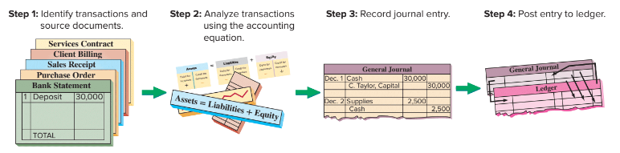
Journalizing and Posting Transactions
Exhibit 2.9
© McGraw-Hill Education
Learning Objective A1: Analyze and record transactions and their impact on financial statements.
Notes:
In the accounting process, you first analyze a transaction by looking at proper source documentation. Next, we apply the rules of double-entry accounting and record a general journal entry. The general journal is a chronological listing of the transactions. At the end of the accounting period, we post the information from the general journal to the proper general ledger account. The general ledger groups all transactions that impact a particular account. That is, all the transactions that increase or decrease the Cash account are posted to the general ledger Cash account.

Slide 19
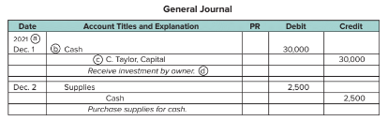
Journalizing Transactions
Transaction Date
Title of accounts debited and amount entered in Debit column.
Exhibit 2.10
Title of accounts credited and amount entered in Credit column.
Transaction explanation
Learning Objective A1: Analyze and record transactions and their impact on financial statements.
© McGraw-Hill Education
Notes:
Here is an example of the proper recording of a general journal transaction. We have seen a similar transaction before. In this case, the owner of the business contributes $30,000 cash to start the business.
The transaction occurred on December 1, 2021. The date is important when recording general journal transactions and is recorded on the left side of the journal.
Next we identify the accounts affected by the transactions. The Cash account is an asset that has increased. We show increases in asset accounts with a debit to that account. The Owner, Capital account also increased and we show increases in equity accounts with a credit.
Debits are always listed first in the journal followed by credits that are slightly indented below the debits.
The dollar amount is placed in the appropriate debit or credit column. In this case, the Cash account was debited for $30,000, so we place that amount in the debit column.
Finally, we prepare a brief description of the transaction so that other people who view our work will understand the nature of the transaction. This explanation is indented about as far as the credited account titles to avoid confusing it with accounts and it is italicized.
When a transaction is first recorded, the posting reference (PR) column is left blank (in a manual system). Later, when posting entries to the ledger, the identification numbers of the individual ledger accounts are entered in the PR column.

Slide 20
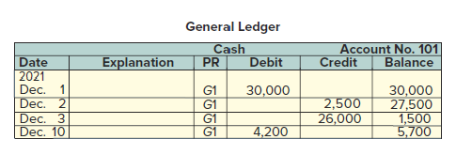
Balance Column Account
Exhibit 2.11
T-accounts are useful illustrations, but balance column accounts are used in practice.
© McGraw-Hill Education
Learning Objective A1: Analyze and record transactions and their impact on financial statements.
Notes:
T-accounts are useful illustrations, but balance column accounts are used in practice.
The balance column account format is similar to a T-account in having columns for debits and credits.
It is different in including transaction date and explanation columns. It also has a column with the balance of the account after each entry is recorded. The Cash account is debited on December 1 for the $30,000 owner investment yielding a $30,000 debit balance. The account is credited on December 2 for $2,500, yielding a $27,500 debit balance. On December 3, it is credited again, this time for $26,000, and its debit balance is reduced to $1,500. The Cash account is debited for $4,200 on December 10, and its debit balance increases to $5,700; and so on.

Slide 21
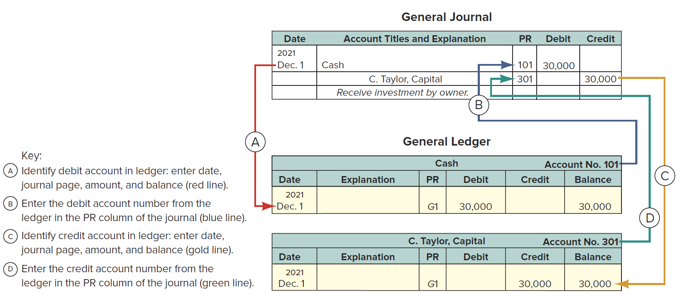
Posting Journal Entries
Exhibit 2.12
© McGraw-Hill Education
Learning Objective A1: Analyze and record transactions and their impact on financial statements.
Notes:
Posting is the process of transferring the information from the general journal to the general ledger. There are four steps in the posting process.
Identify debit account in Ledger: enter date, journal page in its PR column, debit amount, and new balance.
Enter the debit account number from the Ledger in the PR column of the journal.
Identify the credit account in Ledger: enter date, journal page in its PR column, credit amount, and new balance.
Enter the credit account number from the Ledger in the PR column of the journal.
posting reference (PR) column

Slide 22
Processing Transactions
Double-entry accounting is useful in analyzing and processing transactions. Analysis of each transaction follows these four steps.
Step 1 Identify transactions and source documents.
Step 2 Analyze the transaction using the accounting equation.
Step 3 Record the journal entry.
Step 4 Post the entry (for simplicity, we use T-accounts as ledger accounts).
© McGraw-Hill Education
Learning Objective A1: Analyze and record transactions and their impact on financial statements.
Notes:
Double-entry accounting is useful in analyzing and processing transactions. To analyze each transaction follow these four steps:
Identify the transaction and any source documents.
Analyze the transaction using the accounting equation.
Record the transaction in journal entry form applying double-entry accounting.
Post the entry (for simplicity, we use T-accounts to represent ledger accounts).
Let’s look at some examples.

Slide 23
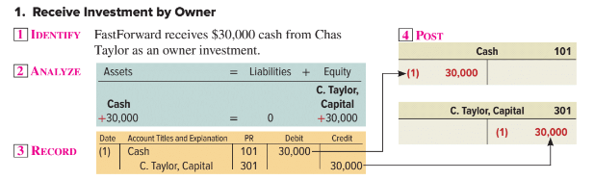
Processing Transactions #1
© McGraw-Hill Education
Learning Objective A1: Analyze and record transactions and their impact on financial statements.
Notes:
In the first transaction, the owner invests $30,000 to start a company called FastForward. From our previous work, we know that the Cash account and the C. Taylor, Capital account will increase.
We record this information in the general journal with a debit, increase, to Cash, and a credit, increase, to C. Taylor, Capital. Notice that the account number for the Cash account is 101 and C. Taylor, Capital is 301. We are going to post the information in the journal to the general ledger. We will use T-accounts to accomplish this.
We place the $30,000 on the left, or debit, side of the Cash account and on the right, or credit, side of the C. Taylor, Capital account. Our books are in balance because total assets are equal to total liabilities plus equity. Let’s move to another transaction.

Slide 24
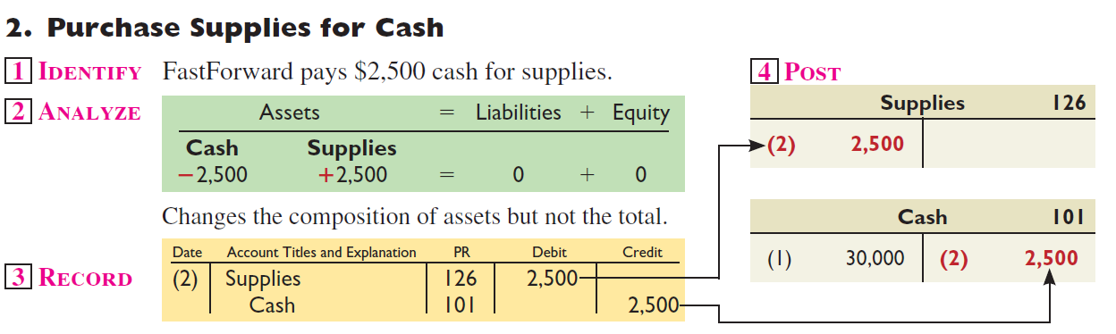
Processing Transactions #2
© McGraw-Hill Education
Learning Objective A1: Analyze and record transactions and their impact on financial statements.
Notes:
In our second transaction, FastForward purchases office supplies, an asset, paying $2,500 cash. We have exchanged one asset, cash, for another asset, supplies. The Cash account will decrease and the Supplies account will increase. Can you make the general journal entry to record this transaction?
We increase the Supplies account with a debit and decrease the asset account, Cash, with a credit. Let’s post the amounts.
The general ledger account for Supplies increased by $2,500, so the amount is placed on the debit side of the account. The Cash account, an asset, decreased by $2,500, so the amount is placed on the credit side of the general ledger account. Let’s move on to another transaction.

Slide 25
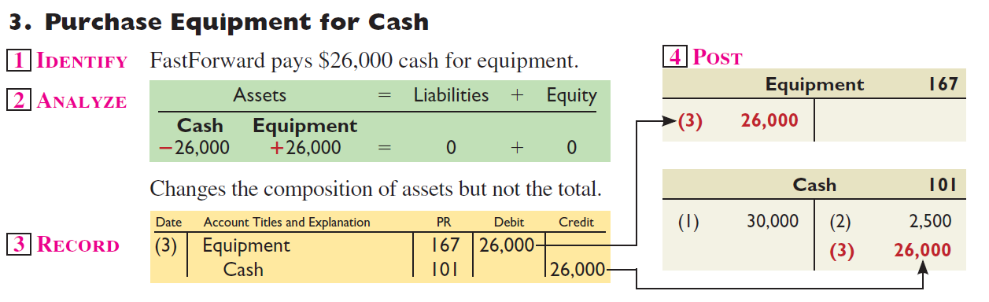
Processing Transactions #3
© McGraw-Hill Education
Learning Objective A1: Analyze and record transactions and their impact on financial statements.
Notes:
In our third transaction, FastForward purchases equipment paying $26,000 cash. Once again, we have exchanged one asset, Cash, for another asset, Equipment. The Cash account will decrease and the Equipment account will increase. This general journal entry will look similar to the one we just completed.
We increase the Equipment account with a debit and decrease the asset account, Cash, with a credit. Let’s post the amounts.
The general ledger account for Equipment increased by $26,000, so it is placed on the debit side of the account. The Cash account, an asset, decreased by $26,000, so the amount is placed on the credit side of the general ledger account. Let’s look at another transaction.

Slide 26
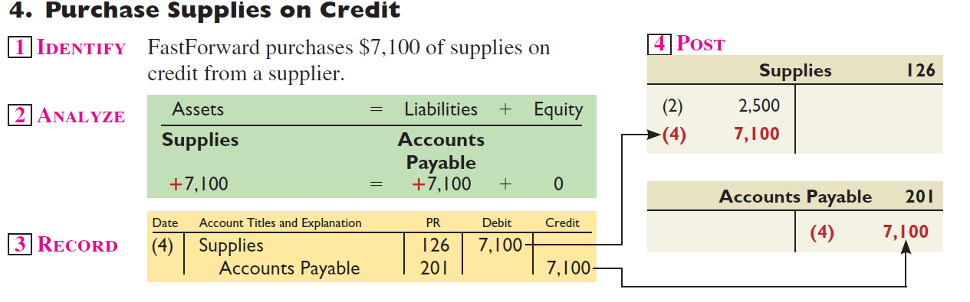
Processing Transactions #4
© McGraw-Hill Education
Learning Objective A1: Analyze and record transactions and their impact on financial statements.
Notes:
In this transaction, FastForward purchases $7,100 of office supplies on account. The Supplies account, an asset, will increase and the liability account, Accounts payable will increase. Let’s make the general journal entry to record this transaction.
We increase the Supplies account with a debit and increase the liability account, Accounts payable, with a credit. It is time to post the transaction.
The general ledger account for Supplies increased by $7,100, so the amount is placed on the debit side of the account. The Accounts payable account, a liability, increased by the same amount, so we place it on the credit side of the general ledger account. Let’s analyze another transaction.

Slide 27
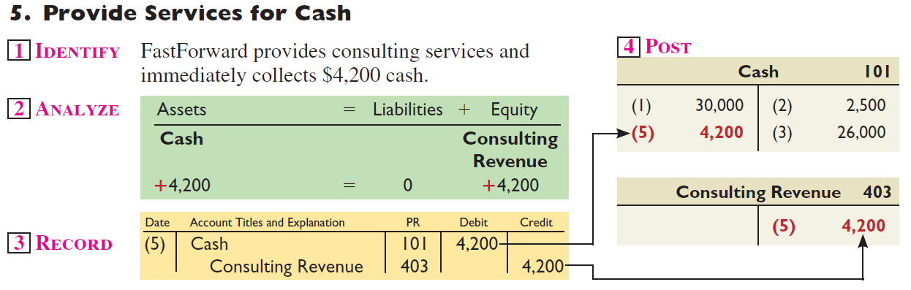
Processing Transactions #5
© McGraw-Hill Education
Learning Objective A1: Analyze and record transactions and their impact on financial statements.
Notes:
FastForward provided consulting services and collected $4,200 cash. The asset account, Cash, increased by $4,200 and the equity account, Consulting revenue, increased by the same amount. See if you can make the general journal entry to record this transaction before moving to the next slide.
We increase the Cash account with a debit and increase the revenue account, Consulting revenue, with a credit. Let’s post the amounts.
The general ledger account for Cash increased by $4,200, so the amount is placed on the debit side of the account. The Consulting revenue account increased by the same amount, so it is placed on the credit side of the general ledger account.

Slide 28
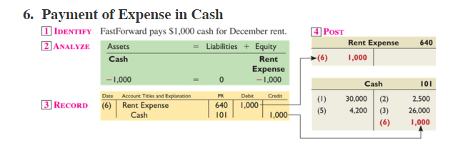
Processing Transactions #6
© McGraw-Hill Education
Learning Objective A1: Analyze and record transactions and their impact on financial statements.
Notes:
FastForward pays $1,000 cash for December rent. The asset account, Cash, decreased by $1,000 and the equity account, Rent expense, increased by the same amount.
We decrease the Cash account with a credit and increase the expense account, Rent expense, with a debit. Let’s post the amounts.
The general ledger account for Cash decreased by $1,000, so the amount is placed on the credit side of the account. The Rent expense account increased by the same amount, so it is placed on the debit side of the general ledger account.

Slide 29
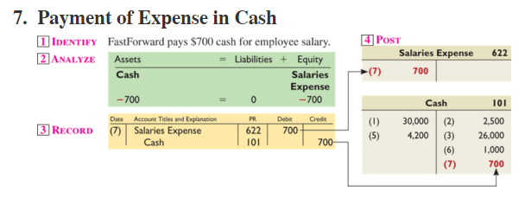
Processing Transactions #7
© McGraw-Hill Education
Learning Objective A1: Analyze and record transactions and their impact on financial statements.
Notes:
FastForward pays $700 cash for employee salaries. The asset account, Cash, decreased by $700 and the equity account, Salaries expense, increased by the same amount.
We decrease the Cash account with a credit and increase the expense account, Salaries expense, with a debit. Let’s post the amounts.
The general ledger account for Cash decreased by $700, so the amount is placed on the credit side of the account. The Salaries expense account increased by the same amount, so it is placed on the debit side of the general ledger account.

Slide 30
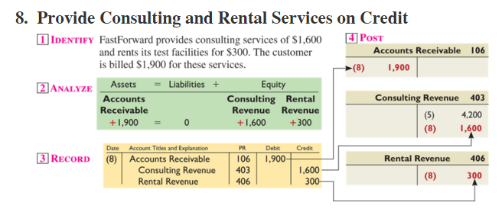
Processing Transactions #8
© McGraw-Hill Education
Learning Objective A1: Analyze and record transactions and their impact on financial statements.
Notes:
FastForward provided consulting services of $1,600 and rents its test facilities for $300. The customer is billed $1,900 for services.
The asset account, Accounts receivable, increased by $1,900, the equity account, Consulting revenue, increased by $1,600 and the equity account, Rental revenue, increased by $300.
We increase the Accounts receivable account with a debit and increase the two revenue accounts, Consulting revenue and Rental revenue, with credits. This is a compound journal entry which affects three or more accounts.
The general ledger account for Accounts receivable increased by $1,900, so the amount is placed on the debit side of the account. The Consulting revenue account increased by $1,600 and Rental revenue increased by $300, so these are placed on the credit side of the general ledger accounts.

Slide 31
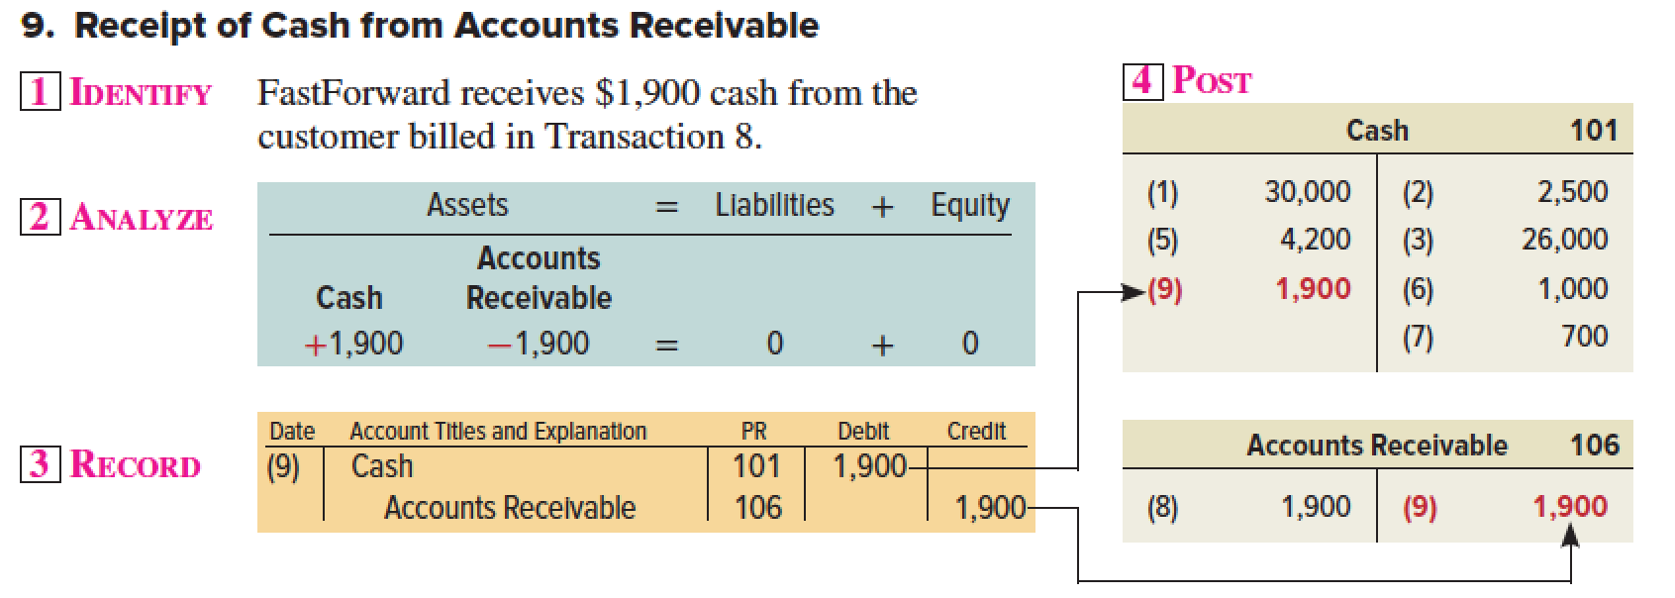
Processing Transactions #9
© McGraw-Hill Education
Learning Objective A1: Analyze and record transactions and their impact on financial statements.
Notes:
FastForward receives $1,900 cash from the client billed in transaction 8. This transaction will increase the Cash account and decrease the Accounts receivable account by $1,900.
We increase the Cash account with a debit and decrease the Accounts receivable account for $1,900.
In posting these amounts to the general ledger accounts, $1,900 is placed on the debit side of the Cash account and $1,900 is placed on the credit side of the Accounts receivable account.

Slide 32
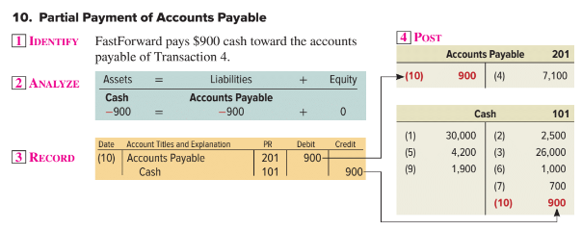
Processing Transactions #10
© McGraw-Hill Education
Learning Objective A1: Analyze and record transactions and their impact on financial statements.
Notes:
FastForward pays $900 cash toward the accounts payable in transaction 4. This transaction will decrease the Cash account and decrease the Accounts payable account by $900.
Decrease the Cash account with a credit and decrease the Accounts payable account with a debit for $900.
In posting these amounts to the general ledger accounts, $900 is placed on the credit side of the Cash account and $900 is placed on the debit side of the Accounts payable account.

Slide 33
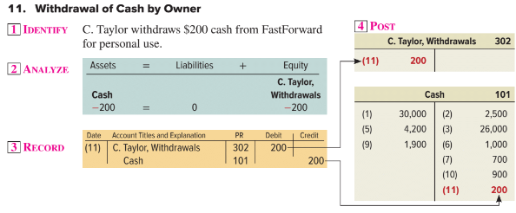
Processing Transactions #11
© McGraw-Hill Education
Learning Objective A1: Analyze and record transactions and their impact on financial statements.
Notes:
C. Taylor withdraws $200 cash from FastForward for personal use. This transaction will decrease the Cash account and increase the C. Taylor, Withdrawals account by $200.
Decrease the Cash account with a credit and increase the C. Taylor, Withdrawals account with a debit for $200.
In posting these amounts to the general ledger accounts, $200 is placed on the credit side of the Cash account and $200 is placed on the debit side of the C. Taylor, Withdrawals account.

Slide 34
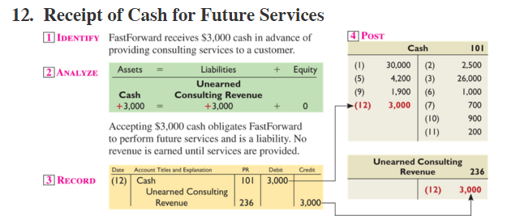
Processing Transactions #12
© McGraw-Hill Education
Learning Objective A1: Analyze and record transactions and their impact on financial statements.
Notes:
FastForward receives $3,000 cash in advance of providing consulting services to a customer. This transaction will increase the Cash account and increase the liability account, Unearned consulting revenue account by $3,000.
We increase the Cash account with a debit and increase the Unearned consulting revenue account with a credit for $3,000.
In posting these amounts to the general ledger accounts, $3,000 is placed on the debit side of the Cash account and $3,000 is placed on the credit side of the Unearned consulting revenue account.

Slide 35
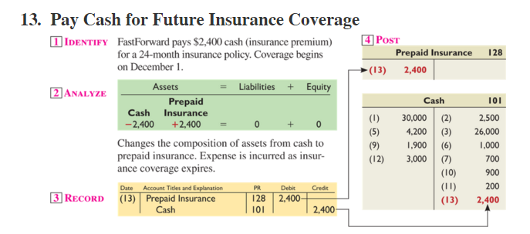
Processing Transactions #13
© McGraw-Hill Education
Learning Objective A1: Analyze and record transactions and their impact on financial statements.
Notes:
FastForward pays $2,400 cash for a 24-month insurance policy. This transaction will decrease the Cash account and increase the asset account, Prepaid insurance, by $2,400.
Decrease the Cash account with a credit and increase the Prepaid insurance account with a debit for $2,400.
In posting these amounts to the general ledger accounts, $2,400 is placed on the credit side of the Cash account and $2,400 is placed on the debit side of the Prepaid insurance account.

Slide 36
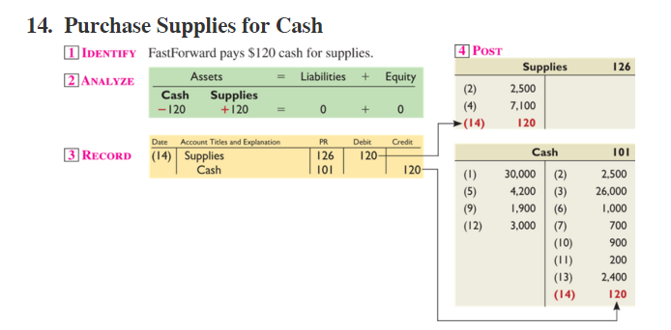
Processing Transactions #14
© McGraw-Hill Education
Learning Objective A1: Analyze and record transactions and their impact on financial statements.
Notes:
FastForward pays $120 cash for supplies. This transaction will decrease the Cash account and increase the asset account, Supplies account by $120.
Decrease the Cash account with a credit and increase the Supplies account with a debit for $120.
In posting these amounts to the general ledger accounts, $120 is placed on the credit side of the Cash account and $120 is placed on the debit side of the Supplies account.

Slide 37
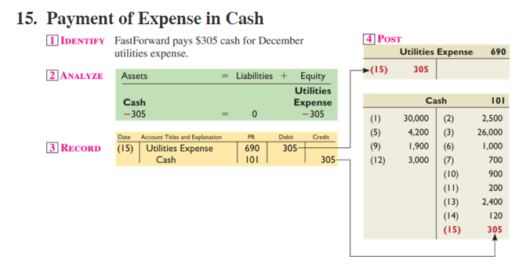
Processing Transactions #15
© McGraw-Hill Education
Learning Objective A1: Analyze and record transactions and their impact on financial statements.
Notes:
FastForward pays $305 cash for December utilities expense. This transaction will decrease the Cash account and increase the equity account, Utilities expense account by $305.
Decrease the Cash account with a credit and increase the Utilities expense account with a debit for $305.
In posting these amounts to the general ledger accounts, $305 is placed on the credit side of the Cash account and $305 is placed on the debit side of the Utilities expense account.

Slide 38
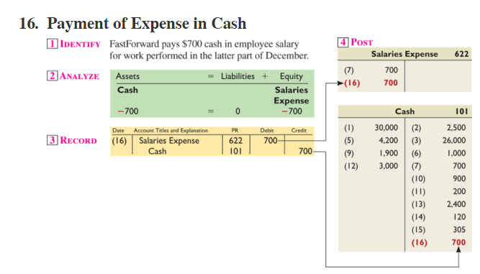
Processing Transactions #16
© McGraw-Hill Education
Learning Objective A1: Analyze and record transactions and their impact on financial statements.
Notes:
FastForward pays $700 cash for employee salaries. The asset account, Cash, is decreased by $700 and the equity account, Salaries expense, is increased by the same amount.
We decrease the Cash account with a credit and increase the expense account, Salaries expense, with a debit. Let’s post the amounts.
The general ledger account for Cash decreased by $700, so the amount is placed on the credit side of the account. The Salaries expense account increased by the same amount, so it is placed on the debit side of the general ledger account.

Slide 39
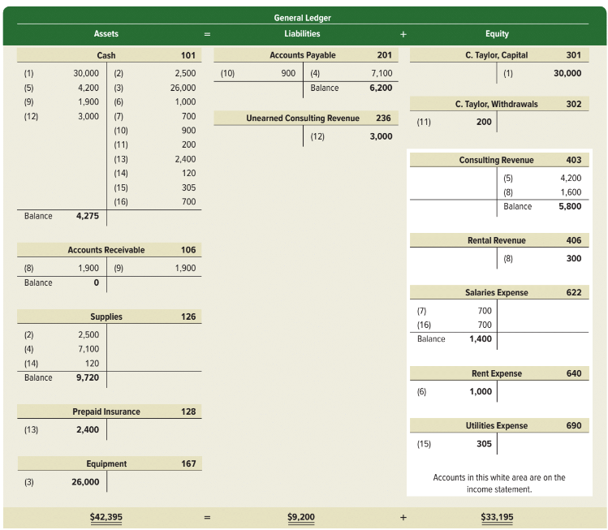
Summarizing Transactions in a Ledger
Exhibit 2.13
© McGraw-Hill Education
Learning Objective A1: Analyze and record transactions and their impact on financial statements.
Notes:
Exhibit 2.13 shows the ledger accounts (in T-account form) of FastForward after all 16 transactions are recorded and posted and the balances computed. The accounts are grouped into three columns corresponding to the accounting equation: assets, liabilities, and equity. The totals for the three columns obey the accounting equation: assets equal $42,395 ($4,275 + $0 + $9,720 + $2,400 + $26,000); liabilities equal $9,200 ($6,200 + $3,000); and equity equals $33,195 ($30,000 - $200 + $5,800 + $300 - $1,400 - $1,000 - $305) which obey the accounting equation: $42,395 = $9,200 + $33,195. The owner, capital, owner, withdrawals, revenue, and expense accounts reflect transactions that change equity. These four accounts make up the statement of owner’s equity.

Slide 40
Preparing a Trial Balance
Preparing a trial balance has three steps:
List each account title and its amount (from ledger) in the trial balance.
Compute the total of debit balances and the total of credit balances.
Verify (prove) total debit balances equal total credit balances.
Learning Objective P1: Prepare financial statements from a trial balance.
© McGraw-Hill Education
Notes:
Preparing a trial balance has three steps:
List each account title and its amount (from ledger) in the trial balance.
Compute the total of debit balances and the total of credit balances.
Verify (prove) total debit balances equal total credit balances.
The total of debit balances equals the total of credit balances for the trial balance. However, equality of these two totals does not guarantee that no errors were made.

Slide 41
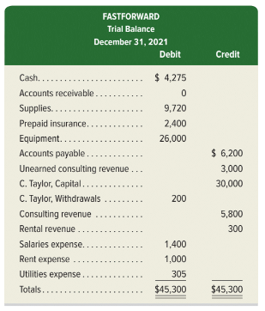
FastForward’s Trial Balance
Exhibit 2.14
The trial balance lists all ledger accounts and their balances at a point in time. If the books are in balance, the total debits will equal the total credits.
Learning Objective P1: Prepare financial statements from a trial balance.
© McGraw-Hill Education
Notes:
The total of debit balances equals the total of credit balances for the trial balance as shown in this slide. Equality of these two totals does not guarantee that no errors were made. For example, the column totals still will be equal when a debit or credit of a correct amount is made to a wrong account. Another error that does not cause unequal column totals occurs when equal debits and credits of an incorrect amount are entered.

